Slide 1
OKC Quality Staff Meeting 8/23/16

Slide 2

Agenda
Safety Moment
Waterfall Communication
Updates
Wrap up

Slide 3

Safety Moment

Slide 4
Waterfall Communication
Audit
Nutron:
CSA, Certs, QPs/ITPs, Documentation
Inspection helping breakdown
Next week topic: Soel on accessing standards with IHS

Slide 5


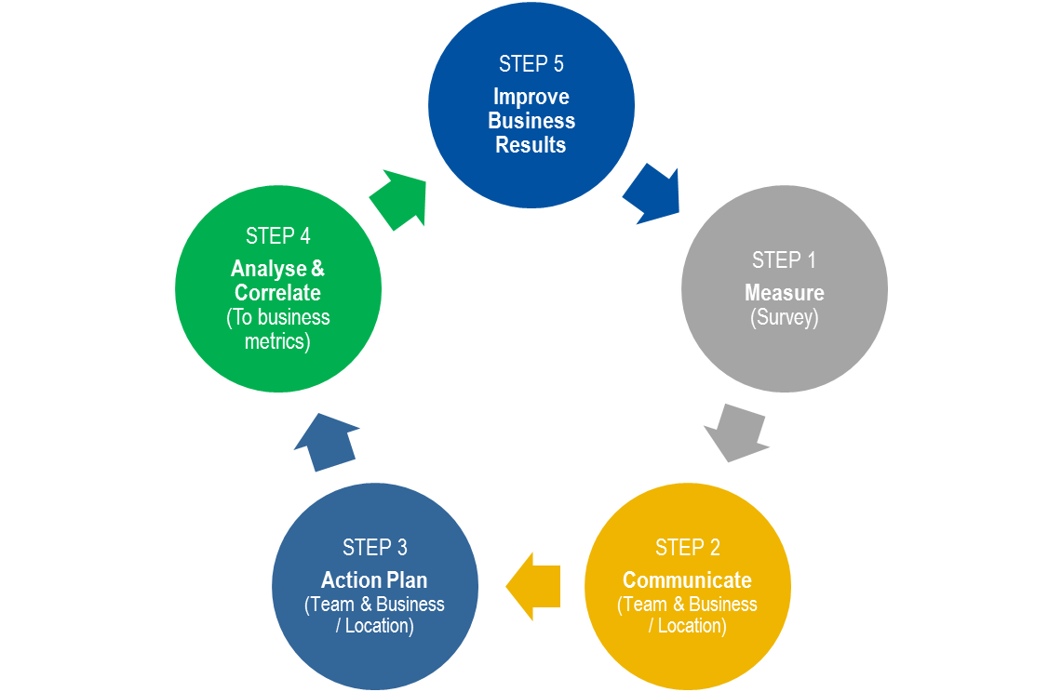


E2E
All employees complete the on-line survey* beginning September 1st
We will review the results as a team and plan follow-up actions

Slide 6
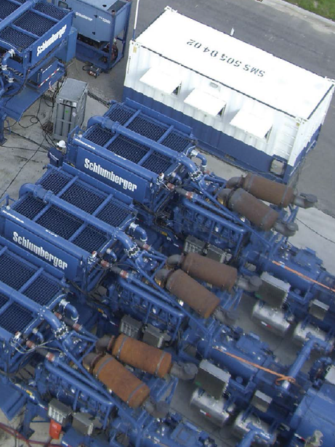

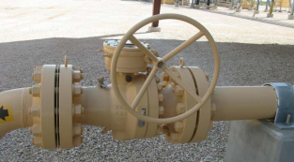
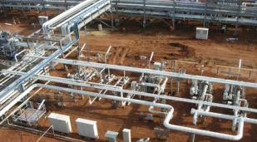
Updates
Notes:
AK: CCM
JW: New layout
SS: PCP for Demco, rework so high for APR-16?, FPY data slices, CARs
RL: ITP project, RRK, CRI
RC:

